Slide 1
Discrete Mathematics
Instructor
Minhajul Bashir Lecturer, UIU

Slide 2
About me ☺
Minhajul Bashir (Shovan), Lecturer
H.S.C. in 2009
Graduation year: 2015, from BUET
Joined UIU in Summer, 2016 trimester
Facebook: https://fb.com/shovan.livebd

Slide 3
Course policies
Attendance
Marks will be proportional to your total attendance in the course
Assignment
Written assignments
Marks of all assignments will be averaged
Class tests
Minimum 4 class tests will be taken
Best 3 class tests will be considered
Look for bonus marks!!!

Slide 4
Course policies
Materials and announcements will be posted in eLMS
Look for CSI 219 (NG) in eLMS, and enroll yourself
Enrolment key: 2486
If there is any trouble accessing eLMS, contact IT immediately
A Facebook group will be opened for discussion
Will be posted in eLMS tonight
Inbox me your name and ID before joining only if you are using a different name in Facebook

Slide 5
So, let’s begin!!!

Slide 6
Which topics will we cover?

Slide 7
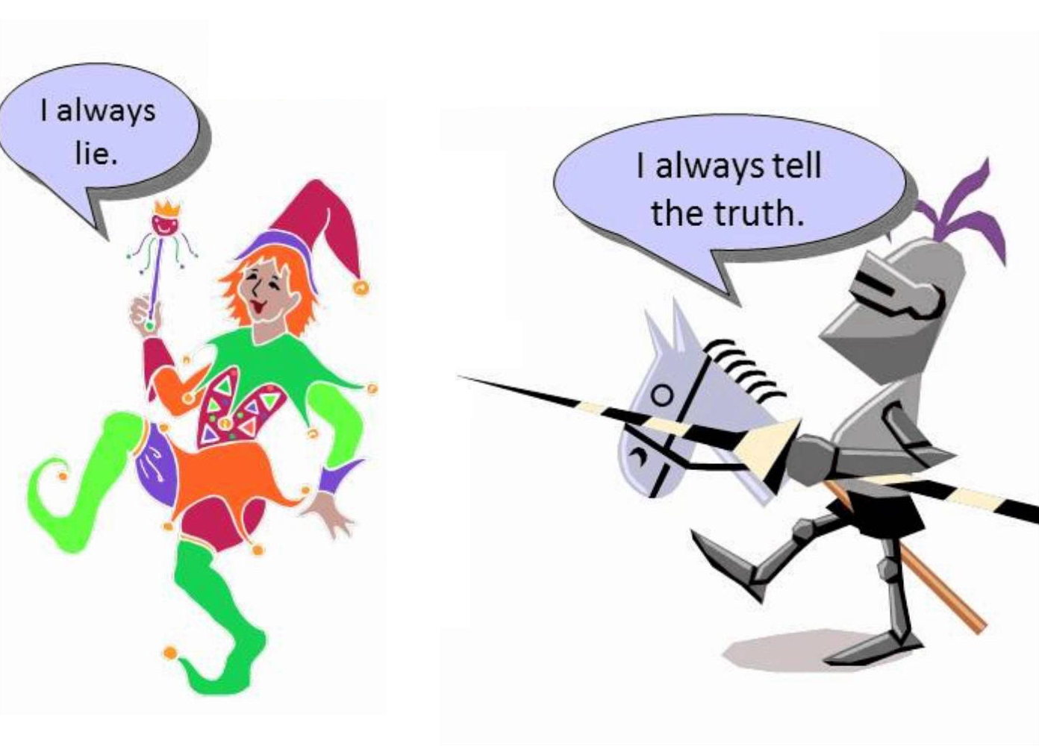
Logic and proofs

Slide 8
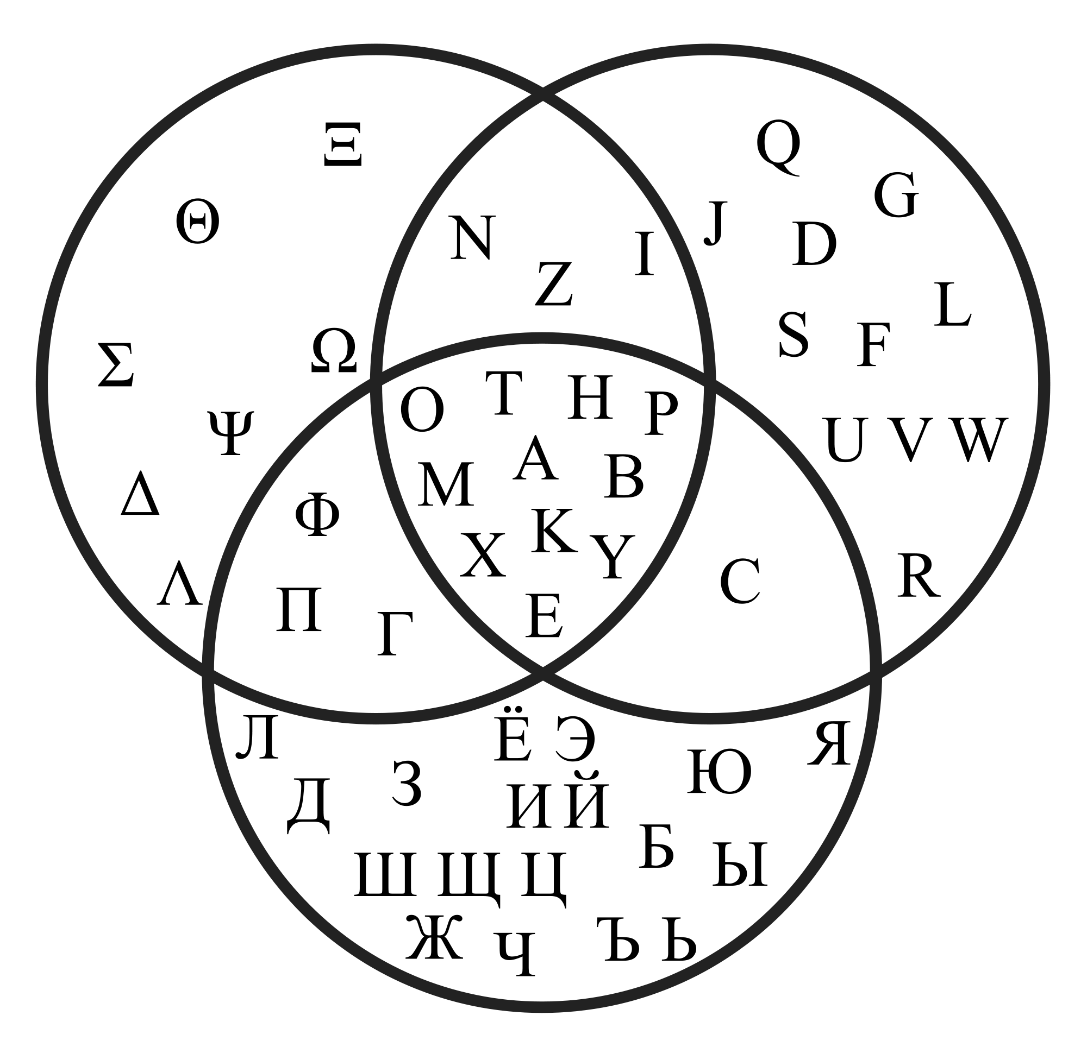
Sets and Functions

Slide 9
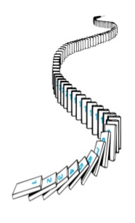
Mathematical Induction

Slide 10
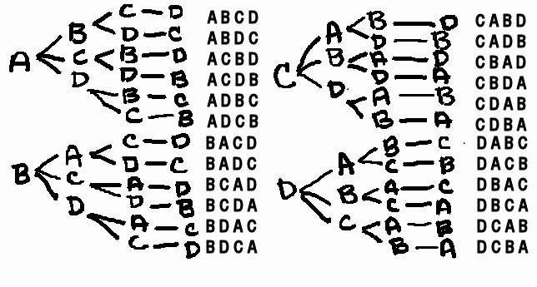
Counting problems

Slide 11
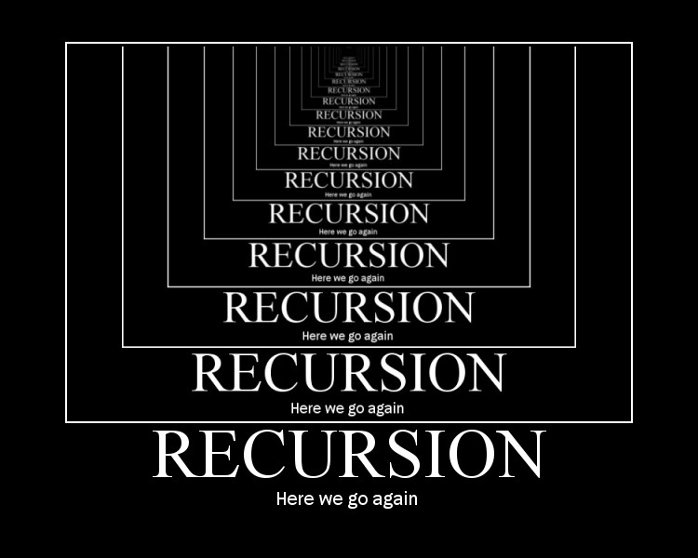
Recurrence relations

Slide 12
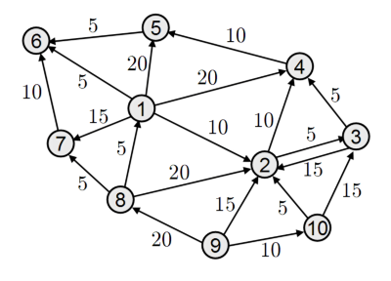
Graphs and Trees

Slide 13
But why do we call it discrete math??

Slide 14
Discrete math is the math of discrete things

Slide 15
Math of discrete things
Propositions, predicates, graphs, trees are discrete objects
Counting, induction, recurrence involve discrete objects and techniques
Even the sets/functions we discuss will involve discrete objects

Slide 16
So, why study DM as a CS course???

Slide 17
Computer is a machine of discrete objects!!!

Slide 18
Machine of discrete objects
Memory units are divided into bits (0 or 1) – discrete entity!!!
Even continuous quantities (like real numbers) are represented as discrete entities!!!
Approximations of real numbers to a very large precision

Slide 19
Discrete math is the base of Computer Science!!!

Slide 20
Base of Computer Science
Logics, proofs, sets, functions, recurrence, graphs, trees …
Basic building blocks of more advanced CS topics like data structures, algorithms, …
Basic building blocks for problem solving!!!

Slide 21
Okay, let’s begin!!!

